Slide 1
Scientific Writing
Dirk Riehle, Univ. Erlangen
NYT E01
Licensed under CC BY 4.0 International

Slide 2
Agenda
The research paper
Sections of a research paper
Final research theses
Academic writing

Slide 3
1. The Research Paper

Slide 4
Research Papers
A research paper is
A scientific article published after passing peer review
Scientific peer review is
The review (assessment) of some artifact by scientific peers
The research paper is the gold standard of scientific publication

Slide 5
Other Types of Research Publications
Other types of research publications of varying quality
Public reviews
Monographies (books)
Presentation slides (lecturing)
Opinion pieces e.g. letters to the editor
The goal is public documented scientific exchange

Slide 6
2. Sections of a Research Paper

Slide 7
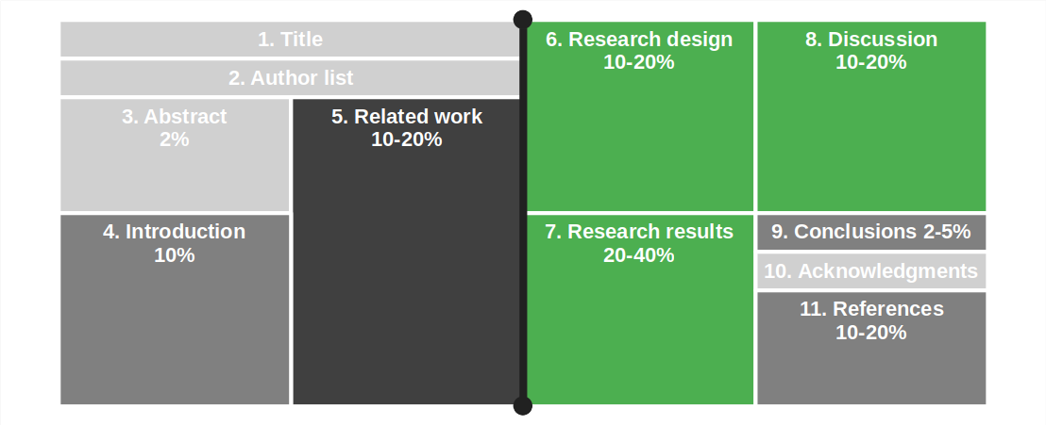
Structure of a Typical Research Paper

Slide 8
1. Title
The purpose of a paper’s title is to
Attract readers
Indicate content
Good paper titles are
Context dependent (where will this be published)
Properly feed academic search engines

Slide 9
Examples of Paper Titles
Great title
“A rational design process: How and why to fake it”
Good title
“Nailing your thesis” (you be the judge)
Poor title
“A comparative evaluation of common theories in computer science”

Slide 10
Best Practices for Paper Titles
Do
Raise reader interest
Be short and memorable
Carry a message
Indicate story
Don’t
Be long and academic
Be incomprehensible
Be overly cute

Slide 11
2. Author List
The purpose of the author list is to
Name and identify authors
Rank-order their contributions
Authors always need to agree to be on an author list and at which position

Slide 12
Who Can be Listed as an Author?
An author to a research paper must have made
A non-trivial intellectual contribution to the presented scientific work
Authors of other contributions go into the acknowledgement section

Slide 13
How to Rank Order Author Lists
There is a logic to the author ordering
Minimum contribution gets you on
Ranking of contribution moves you up
Alphabetical ordering after that
Common patterns
Ph.D. student followed by supervising professor
First author followed by alphabetical list of other contributors
Principal investigator followed by alphabetical list of all project members

Slide 14
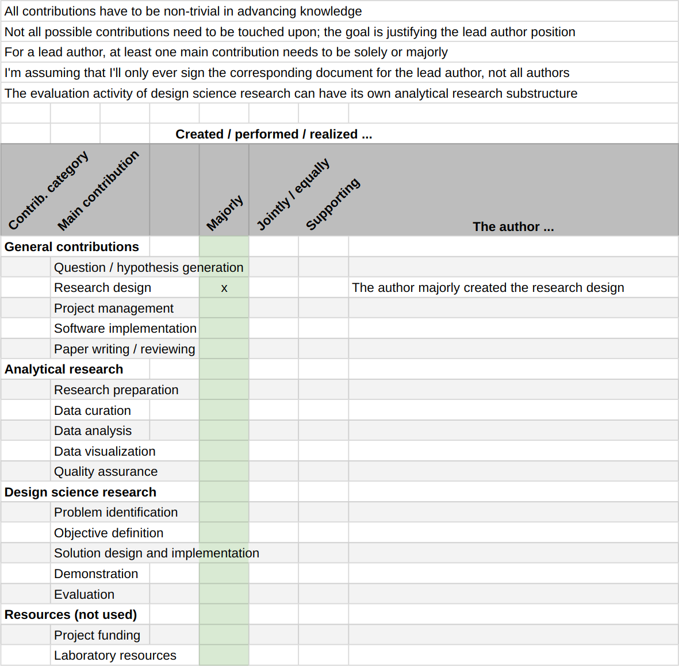
Rank Ordering Intellectual Contributions
Use a contribution model
To first document contributions
Then to rank-order them

Slide 15
3. Abstract
The purpose of an abstract is to
Draw readers in
Summarize the paper
Most readers are lost in the abstract

Slide 16
Generic Best Practice Pattern
One sentence each describing the
Context / domain
Research problem
Approach taken
Research results
Consequences of work
(1) Open-source software is available for free and many companies use it in their software.
(2) However, managers worry that open source is only a temporary phenomenon and will go away, leaving them with abandoned software components that nobody is maintaining.
(3) This article empirically analyses the growth of open-source software using the top 1000 projects from GitHub.
(4) We show that open source is alive and keeps growing.
(5) Thus, open source is a sustainable phenomenon and managers can use open-source software in their products.

Slide 17
Beck’s Four-Sentence Abstract
One sentence each describing the
The problem
Why the problem is a problem
One “startling sentence”
Implications of findings
(1) Users of open-source software worry that the open source phenomenon is not sustainable.
(2) They hesitate to adopt open-source software and miss out on its economic benefits.
(3) This paper shows that open source is a sustainable phenomenon.
(4) Thus, users should not worry but adopt and gain the benefits of open-source software.

Slide 18
4. Introduction
The purpose of the introduction section is to
Keep drawing in the reader
Set expectations straight
Get going with the paper
Most readers’ belief is lost in the introduction

Slide 19
Structure of the Introduction Section
The introduction section
Extends the abstract
Contrasts most-relevant work
Explicitly lists contributions of work
Summarizes the structure of the paper

Slide 20
The Claim to Contributions
You should claim your contributions,
explicitly, and
as precisely as you can
The contributions of this paper are:
An operational definition of how to measure open source project growth;
The assessment of past open source growth using a large sample representative of open source;
The now plausible prediction that open-source software as a whole will keep growing in the future.

Slide 21
5. Related Work
A related work section surveys
Prior art you are building on
Related work (to yours)
Related work is identified through a literature survey
Typically an ad-hoc literature survey
A structured literature review

Slide 22
Prior Art
Prior art (work) is work you build on
You needed it to perform your work
Readers need it to understand your work
Prior work does not compete with yours

Slide 23
Related Work
Related work is work that may have
Attempted the same as your work
Have gone alternative ways
You need to compare-and-contrast this work
You compare to show how the works relate to each other
If the work is not related, it is irrelevant to your paper
You contrast to show how your work is different
If not different from yours, your work is not novel

Slide 24
Presentation Structure
You typically structure related work by
Domains first
Application domain, technical domain, etc.
Then specialize within domain
From the more general to the more specialized work

Slide 25
6. Research Design
The research design section
Presents your research design, methods employed, etc.
Serves to convince readers of rigor of work
The section is also known as
Approach or
Methods
The specifics depend on your research design

Slide 26
Presentation of Research Design Section
The research design section
Presents the logical structure of the research
Presents a one-shot rationalized process
Discuss iterative process in own subsection

Slide 27
Example of a Research Design Section
Example structure (systematic review)
Research approach
Research design
Research questions
Research protocol
Research execution
Study search
Study selection
Study quality filter
Data extraction
Data synthesis

Slide 28
7. Research Results
The research results section
Presents setup, data collection, and data analysis
Provides basis of relevance of your work
The specifics also depend on your research design
The results typically mirror the design section structure

Slide 29
8. Discussion
The discussions section
Discusses your research results
Establishes (beyond the results section) their quality
The specifics depend on the type of research

Slide 30
Discussion in Qualitative Research Papers
In qualitative research, also often called discussion and limitations
Two separate (sub)sections, one each on
Interpreting research results
Limitations (using qualitative research quality criteria)

Slide 31
Discussion in Quantitative Research Papers
In quantitative research, also often called threats to validity
Two separate (sub)sections, one each on
Interpreting research results
Threats to validity (using quantitative research quality criteria)

Slide 32
Structure of Limitations / Threats to Validity
Break down by relevant quality criterion
Feel free to choose relevant criteria beyond the core four
You should always put weaknesses / challenges into context
Explain their consequences

Slide 33
9. Conclusions
The conclusions section
Reiterates the main contributions and their significance
Some readers jump from abstract to conclusions directly
Skip any outlook on future work

Slide 34
10. Acknowledgments
List all people and thank them
Who made a contribution that was relevant but
Not enough to make them an author
Increasingly also
Who made which contribution that made them an author
Expressed using a contribution model (see author list)

Slide 35
11. References
The references section is
A list of literature references used by the paper
A literature reference is
An identifying description of the paper’s sources
The references typically list articles referenced in the paper
They are usually sorted alphabetically

Slide 36
Working with References
The main body of a paper short-hand references the references, for example:
“We use Braun & Clarke (2012) as our qualitative data analysis method.”
The short-hand reference serves as index into the references:
Braun, V., & Clarke, V. (2012). Thematic analysis. APA.

Slide 37
Short-hand Reference (Indexing) Formats
Reference (key) | Referenced entry (value)
[27] | Spector, A. Z. 1989. Achieving application requirements. In Distributed Systems, S. Mullender, Ed. ACM Press. ACM, New York, NY, 19-33.
[Spe89] | Spector, A. Z. 1989. Achieving application requirements. In Distributed Systems, S. Mullender, Ed. ACM Press. ACM, New York, NY, 19-33.
Spector, A. Z. (1989). | Achieving application requirements. In Distributed Systems, S. Mullender, Ed. ACM Press. ACM, New York, NY, 19-33.

Slide 38
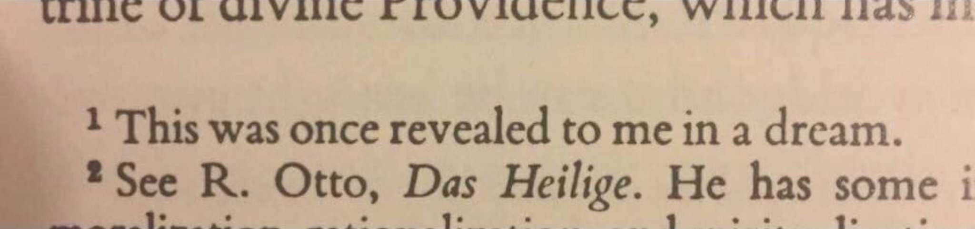
Not an Appropriate Literature Reference

Slide 39
3. Final Research Theses

Slide 40
Final Research Theses
We offer three options for final research theses
Pure research thesis
Design science thesis
Engineering thesis

Slide 41
Pure Research Thesis
A pure research thesis follows the format of a research paper
It either blows up the format to the full length of a thesis, or
It presents the results as a research paper, followed by an elaboration

Slide 42
Design Science Thesis
A design science thesis is a research thesis using a design science structure

Slide 43
Engineering Thesis
An engineering thesis serves to demonstrate the student’s engineering skills
The thesis structure follows the project results, for example:
Requirements
Design
Implementation
Evaluation of results

Slide 44
Process vs. Results
Science rewards results, not effort (skip process, focus on results)
Do not present work in the sequence you performed it, present only the results
Research questions (research thesis) can be results
Requirements (engineering thesis) can be results
You demonstrated ability to separate process from results is a plus
If you absolutely must describe process, do it in a separate section

Slide 45
4. Academic Writing

Slide 46
First Rule of Writing
First and foremost rule
Know your audience
All writing is specific
Use active voice
“An active voice walks into a bar”
Use passive voice
“The bar was walked into by a passive voice”

Slide 47
Second Rule of Writing
Be brief and concise, or
“Omit needless words” [1]
Variations
Use short sentences
Use subject-verb-object sentences
Avoid common phrases
Avoid imprecise adjectives (“very”)
[1] Strunk & White (1918). Elements of Style. Penguin.

Slide 48
More Best Practices
Avoid weak wording
Avoid imprecise wording
Use data rather than qualifications

Slide 49
Be Brief
Before
“It is suggested to remove any dependency on prerequisite 3 in this experiment to not unduly restrict any possible outcome.”
After
“It is suggested to remove any dependency on prerequisite 3 in this experiment to not unduly restrict the outcome.”

Slide 50
Be Concise
Before
“It is suggested to remove any dependency on prerequisite 3 to not unduly restrict the outcome.”
After
“It is suggested to remove requirement 3.”

Slide 51
Use Active Voice
Before
“It is suggested to remove requirement 3.”
After
“Drop requirement 3.”

Slide 52
Avoid Weak Wording
Examples of weak wording
“We tried to…” (So what?)
“We believe…” (OK, why?)
“Try not. Do or do not. There is no try.”

Slide 53
Avoid Imprecise Wording
Examples of imprecise wording
“Very efficient…” (How efficient?)
“Many occurrences…” (How many?)
Don’t leave your reader guessing

Slide 54
All Rules Break Down, Eventually
“A veterinarian prescribed antibiotics Monday for a camel that lives behind an Iberville Parish truck stop after a Florida woman told law officers she bit the 600 pound animal’s genitalia after it sat on her when she and her husband entered its enclosure to retrieve their deaf dog.” [1]
[1] See https://www.newyorker.com/magazine/2021/12/27/florida-woman-bites-camel

Slide 55
Summary
The research paper
Sections of a research paper
Final research theses
Academic writing

Slide 56
Thank you! Any questions?
dirk.riehle@fau.de – https://oss.cs.fau.de
dirk@riehle.org – https://dirkriehle.com – @dirkriehle

Slide 57
Legal Notices
License
Licensed under the CC BY 4.0 International license
Copyright
© 2012-2023 Dirk Riehle, some rights reserved

